Slide 1
PROCESS SCHEDULING
CSCI315 – OPERATING SYSTEMS
Ibrahim Moustafa 202000938
Youssef Abbas – 202001428
Abdelrahman Medhat – 202002045
Maryam Walid – 202000148
Youssef Mohsen - 202000941

Slide 2
TABLE OF CONTENTS
01
02
03
04
INTRODUCTION
PROBLEM STATEMENT
Might be referred to as the Abstract
This is where we state our problem
METHADOLOGY
FIRST-COME-FIRST SERVE
How we are going to implement a solution
Commonly known as FCFS

Slide 3
TABLE OF CONTENTS
05
06
07
08
SHORTEST-JOB-FIRST
PRIORITY SCHEDULING
Commonly referred to as SJF
You can describe the topic of the section here
ROUND ROBIN
RESULTS
Commonly referred to as RR
The output of our work

Slide 4
ABSTRACT
Scheduling algorithms are vital for efficient resource management in operating systems, and this paper compares four methods (FCFS, SJF, Priority Scheduling, and RR) using Dart code and metrics to provide valuable insights for system administrators and programmers selecting the most suitable algorithm.

Slide 5
01
INTRODUCTION

Slide 6
INTRODUCTION
This paper compares and evaluates five popular process scheduling algorithms (FCFS, SJF, Priority Scheduling, RR, and MLFQ) to understand their advantages and disadvantages in managing system resources.

Slide 7
02
PROBLEM STATEMENT

Slide 8
PROBLEM STATEMENT
Developing a Dart-based system with Flutter UI to simulate and visually represent First-Come-First-Serve (FCFS), Shortest-Job-First (SJF), Priority Scheduling, and Round Robin (RR) algorithms, allowing user input for process details and displaying execution order, average waiting time, and average turnaround time for each process.

Slide 9
03
METHADOLOGY

Slide 10
METHADOLOGY
C programs were developed to implement five scheduling methods, where processes with arrival time, burst time, and priority was used to test and measure turnaround time and waiting time, providing average metrics for the entire set of processes.

Slide 11
04
FCFS

Slide 12
FIRST-COME FIRST-SERVE
FCFS is a simple scheduling method that executes processes in the order of their arrival, but it leads to longer wait times for slow-executing operations with quick arrival times in our implementation where we ordered and executed procedures sequentially based on their arrival time.

Slide 13
05
SJF

Slide 14
SHORTEST-JOB-FIRTS
SJF, a scheduling technique prioritizing tasks with the shortest execution time, aims to minimize average waiting time, and in our implementation, a non-preemptive SJF method was employed where processes were sorted by burst time, and the one with the least burst time was executed first.

Slide 15
06
PRIORITY SCHEDULING

Slide 16
PRIORITY SCHEDULING
Priority scheduling, a system that assigns priority ratings to processes based on importance, executes higher priority processes first, and in our implementation, we utilized a non-preemptive Priority Scheduling method where processes were sorted by priority, and the one with the highest priority was executed first.

Slide 17
06
RR

Slide 18
ROUND ROBIN
Priority scheduling, a system that assigns priority ratings to processes based on importance, executes higher priority processes first, and in our implementation, we utilized a non-preemptive Priority Scheduling method where processes were sorted by priority, and the one with the highest priority was executed first.

Slide 19
06
RESULTS

Slide 20
RESULTS
Our project features a user-friendly interface displaying simulation results visually, providing a clear understanding of each algorithm's workings, advantages, and limitations, allowing user input for process details, and presenting execution order, average waiting time, and average turnaround time for each process.

Slide 21
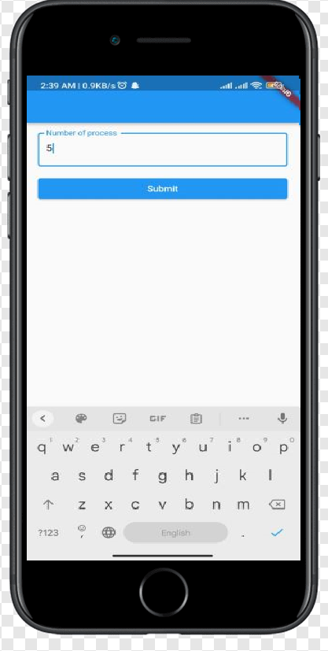
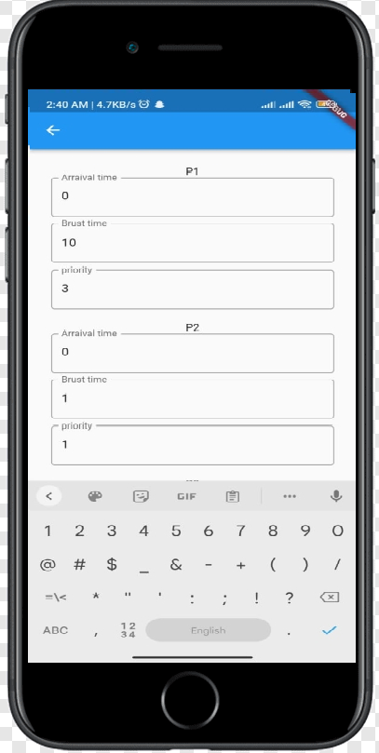
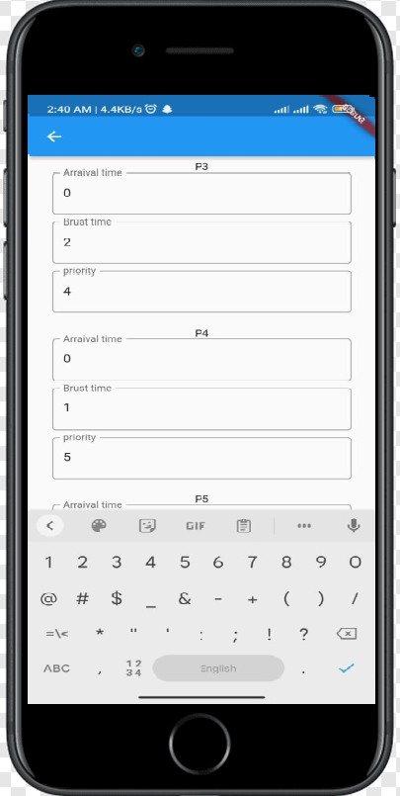

Slide 22
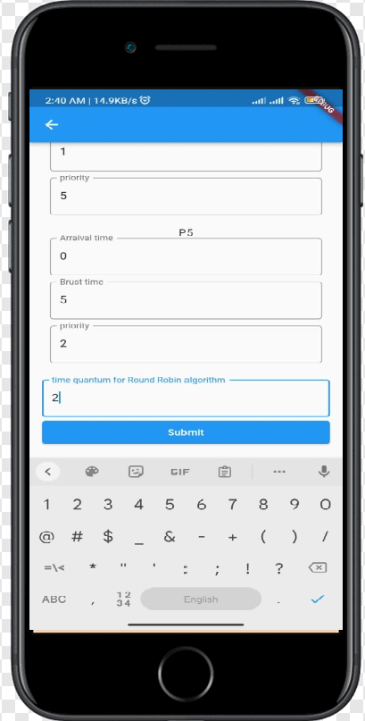
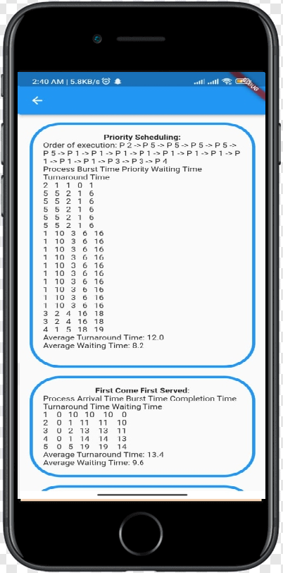
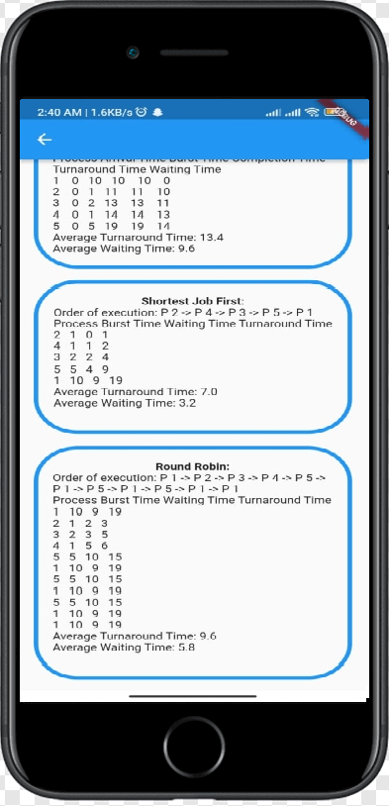

Slide 23
CONCLUSION
Studied FCFS, SJF, Priority Scheduling, RR, and MLFQ methods in Dart code, with MLFQ having fastest times, SJF and Priority facing starvation, RR outperforming FCFS. Our analysis aids in selecting suitable algorithms, and our system handles diverse scenarios efficiently.

Slide 24
REFRENCES:
- Silberschatz, A., Galvin, P. B., & Gagne, G. (2018). Operating system concepts essentials. John Wiley & Sons.
- Tanenbaum, A. S., & Bos, H. (2014). Modern operating systems. Prentice Hall Press.
- Abraham, S., & Raju, K. (2016). A comparative study of CPU scheduling algorithms. International Journal of Engineering Research and General Science, 4(2), 82-87.

Slide 25
THANK YOU!!

